Slide 1
Object-oriented software design
Day: Saturday
Period: 7 -10
Lecturer: Huynh Xuan Phung

Slide 2
Welcome!!
Group 11
Members :
Dang Hoang Son – 1811043
Pham Hoang Phuoc – 1811040
Le Trinh Hoang Phu – 18110037

Slide 3

Design Pattern
1
Factory
4
Adapter
2
Singleton
5
Bridge
3
Prototype
6
Visitor

Slide 4
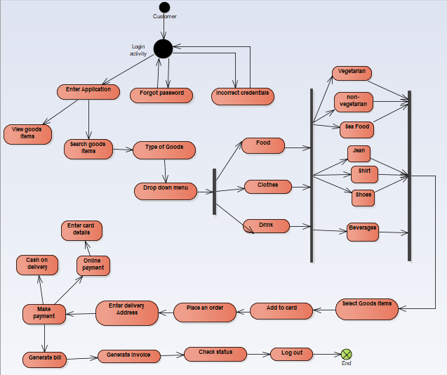
State Diagram

Slide 5
Factory

Slide 6
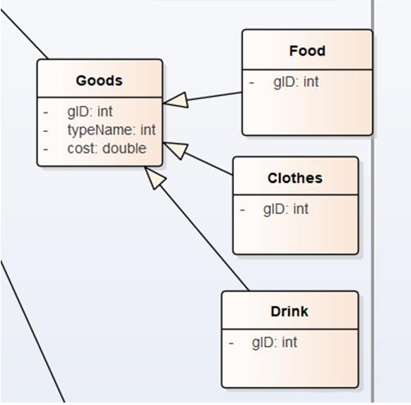
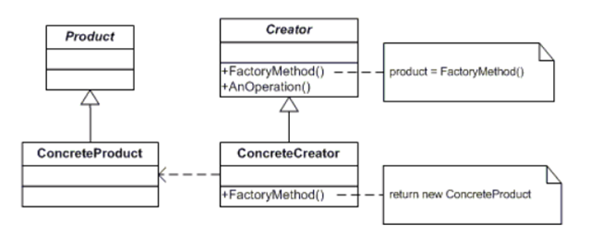
Class Diagram

Slide 7
Infographic Style
ConcreteProduct
This is a class that implements the Product interface.
Product
defines the interface of objects the factory method creates.
Creator
This is an abstract class and declares the factory method, which returns an object of type Product.
ConcreteCreator
This is a class that implements the Creator class and overrides the factory method to return an instance of a ConcreteProduct.
Characteristic
Create objects without exposing the instantiation logic to the client.
Refers to the newly created object through a common interface.

Slide 8

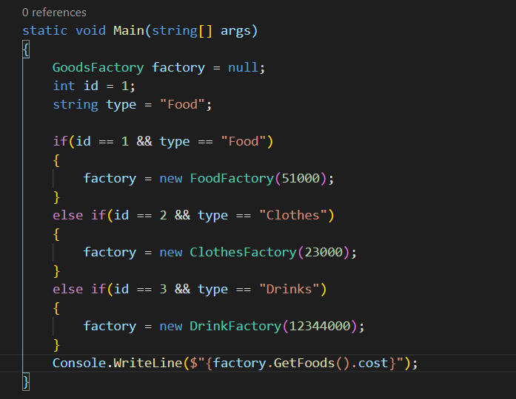
Main function
C# codes

Slide 9
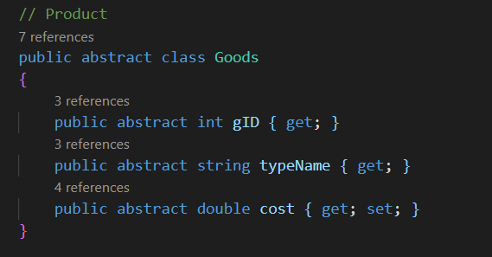
Product
C# codes

Slide 10
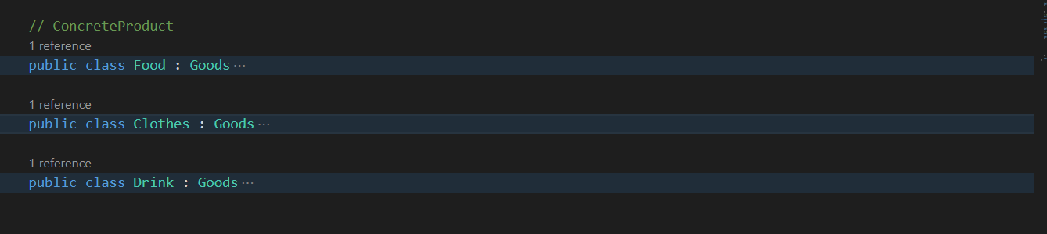
ConcreteProduct
C# codes

Slide 11
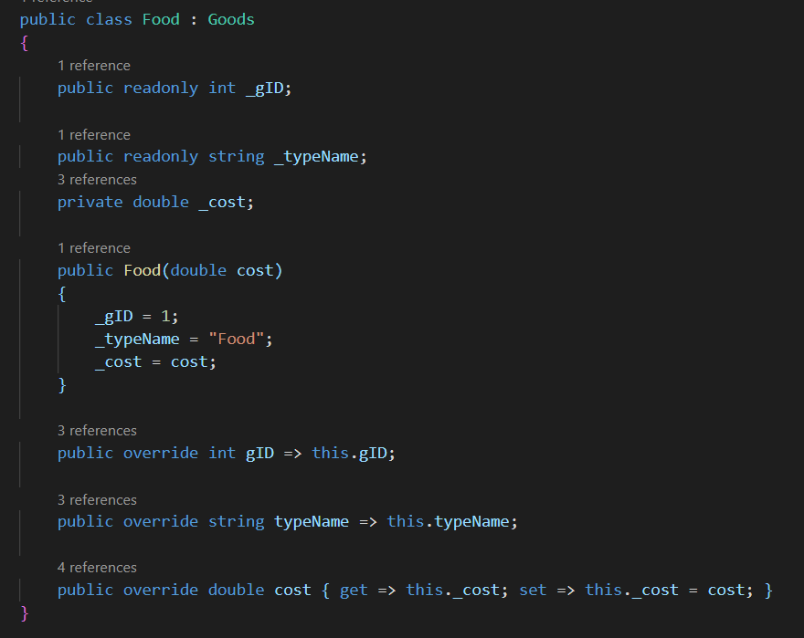
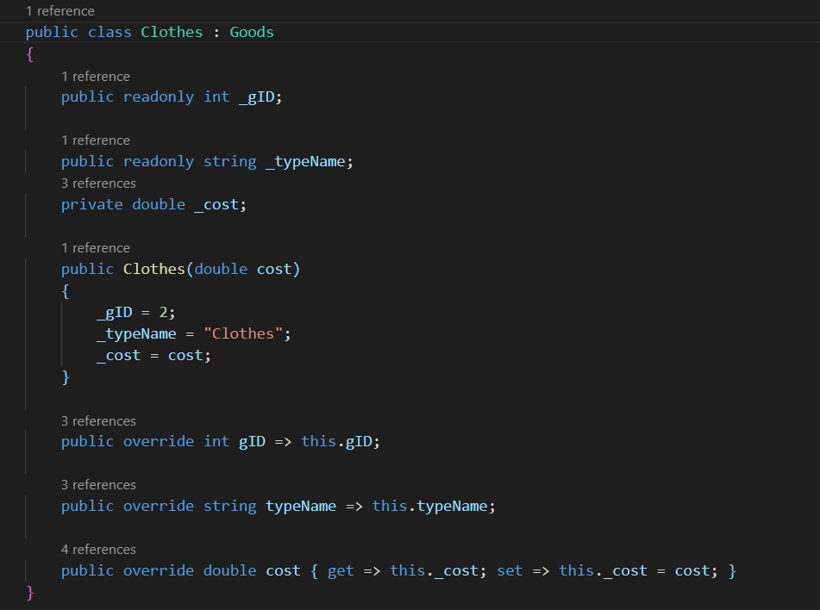
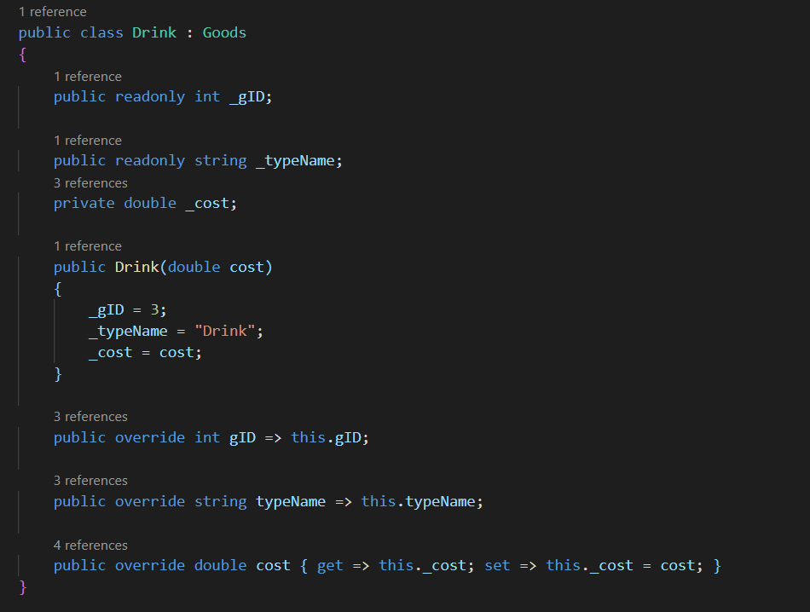

C# codes
Methods

Slide 12
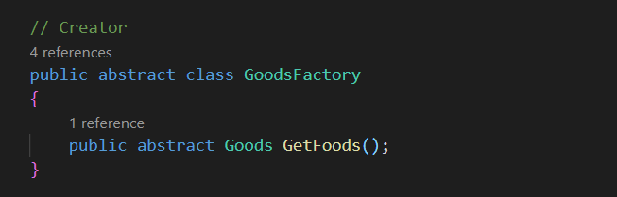
Creator
C# codes

Slide 13
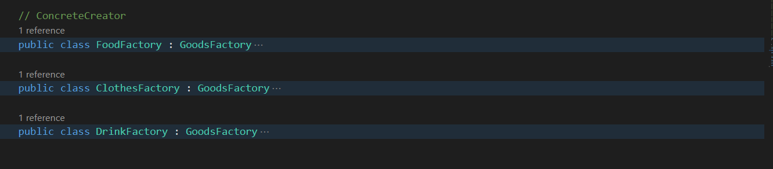
ConcreteCreator
C# codes

Slide 14
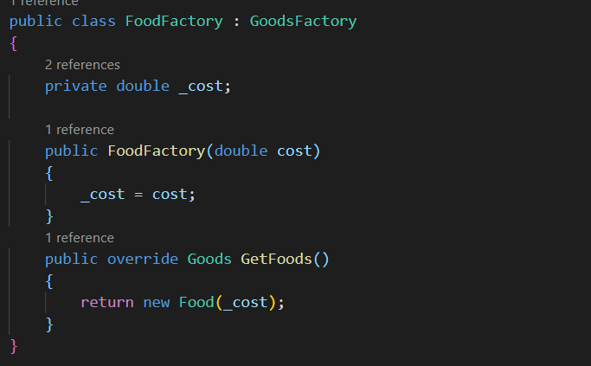
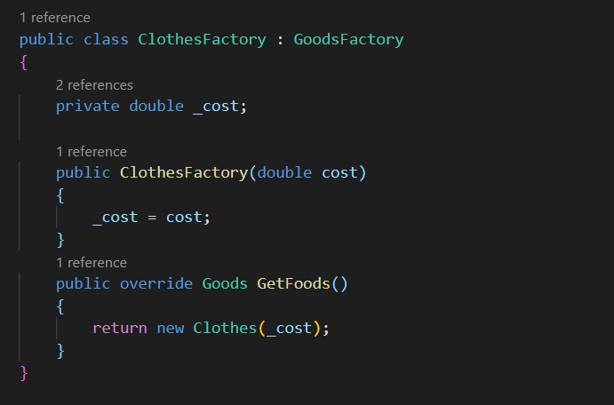
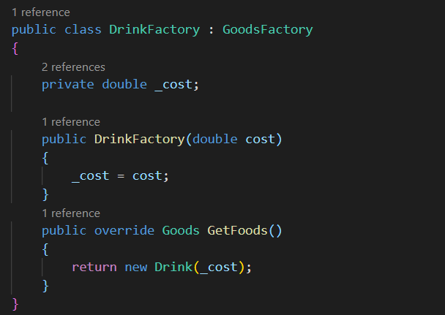
C# codes
Factory

Slide 15
Singleton

Slide 16
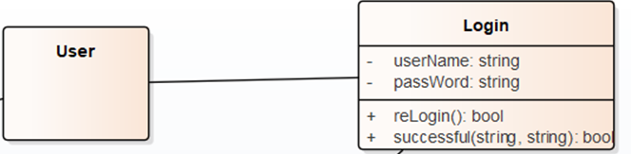
Class Diagram
After login successfully, I will use singleton pattern for getting information of user from database.

Slide 17
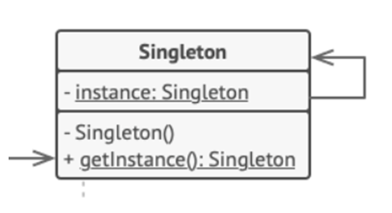
Reason
Use this pattern to get some necessary information of user and save it in User class and public all of information without connecting to database in many time.
Characteristic
Ensure that only one instance of a class is created.
Provide a global point of access to the object.

Slide 18
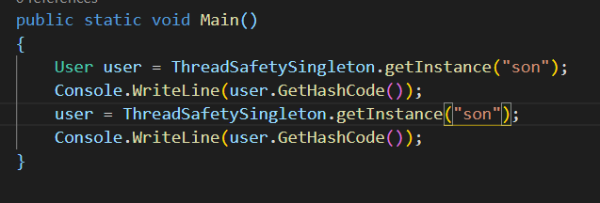
Main Function
C# codes

Slide 19
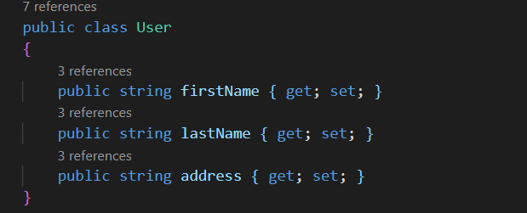
User
C# codes

Slide 20
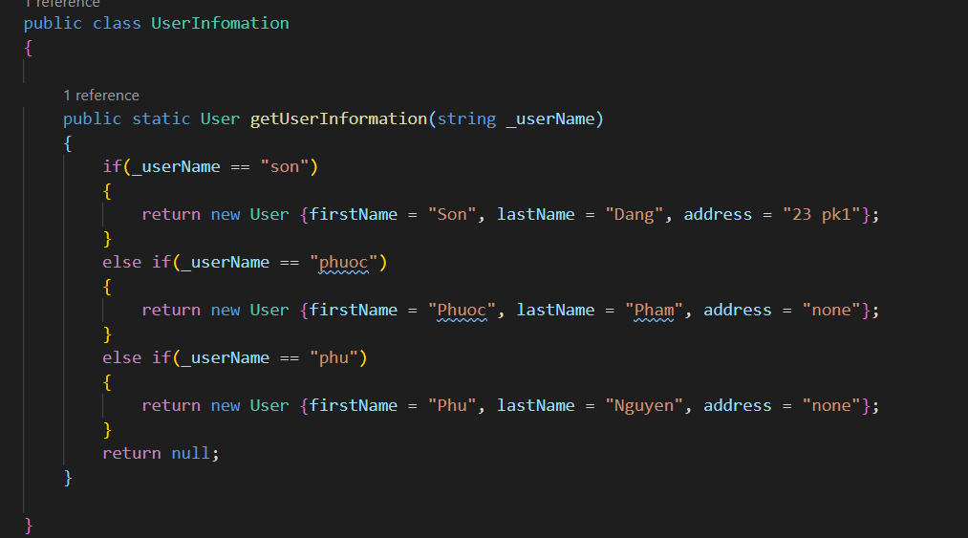
UserInformation function
C# codes

Slide 21
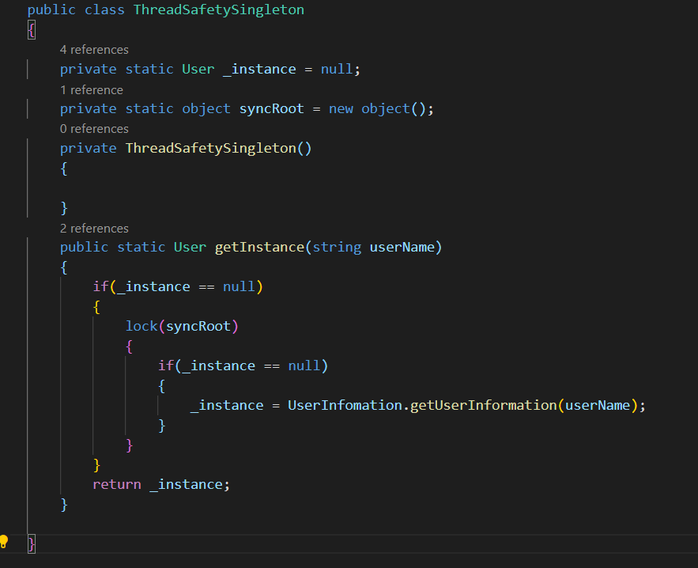
ThreadSafetySingleton Function
C# codes

Slide 22
Prototype

Slide 23
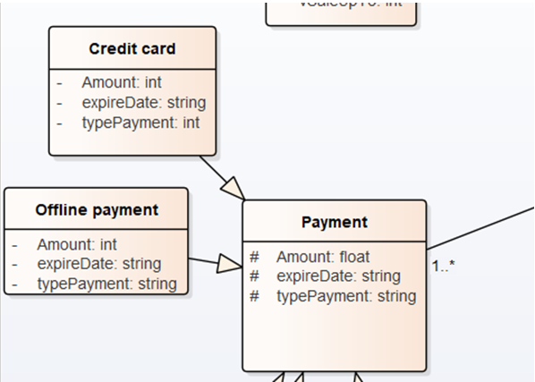
Class Diagram
Reason
Instead of creating 2 method
Offlinepayment
CreditCardPayment
This will lead to looping and not maintain for long
Characteristic
Create objects from a Prototype object by copying the properties of that object.

Slide 24
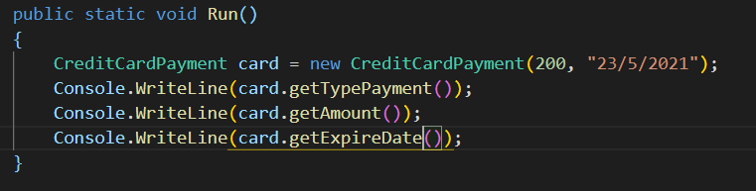
Run Function
C# codes

Slide 25
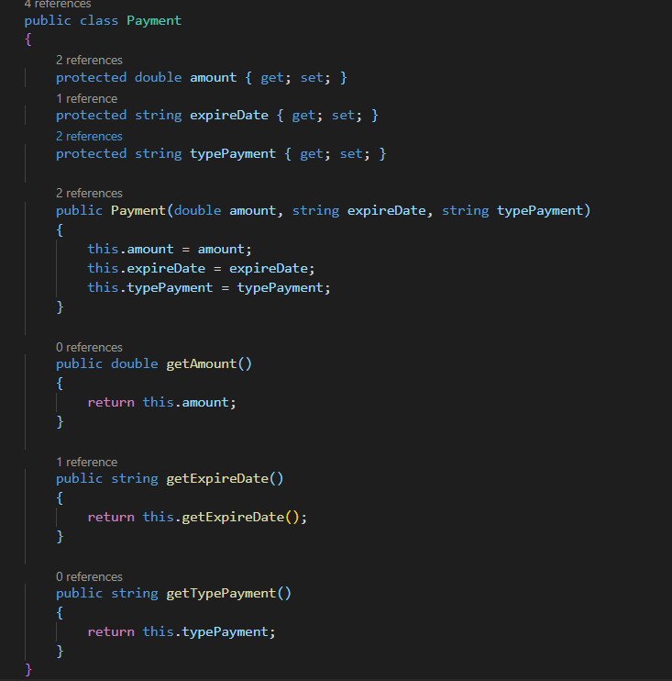
Payment Function
C# codes

Slide 26
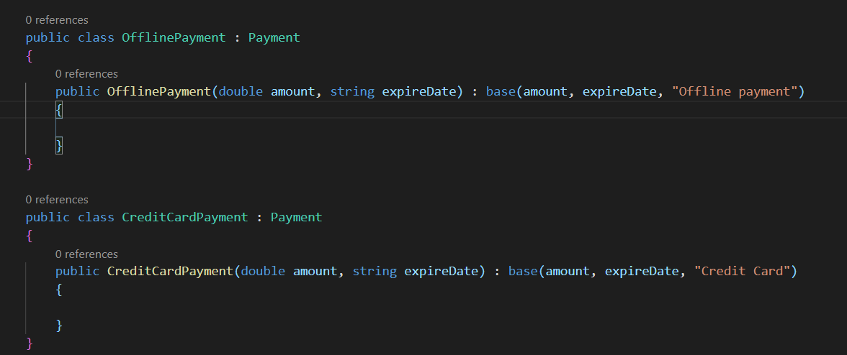
Type of Payment
C# codes

Slide 27
Adapter

Slide 28
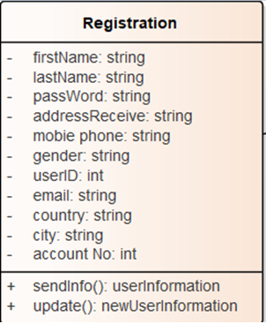
Class Diagram
Reason
Other class which is need to send information or update user information can use ITarget interface. This can help you control easily your code.
Characteristic
Adapter is recognizable by a constructor which takes an instance of a different abstract/ interface type. When the adapter receives a call to any of its method, it translates parameters to the appropriate format and then directs the call to one or several methods of the wrapped object.

Slide 29
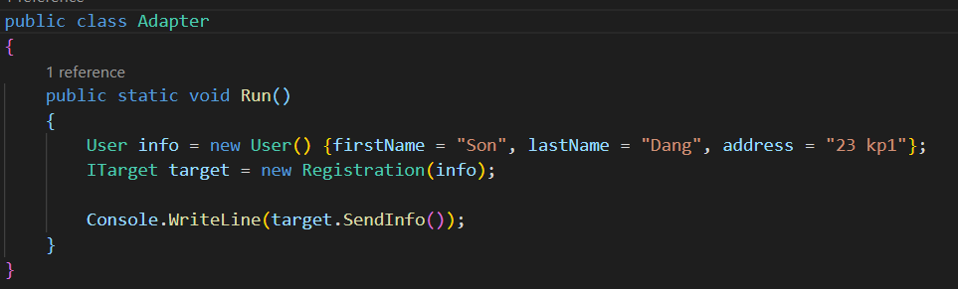
Run Function
C# codes

Slide 30
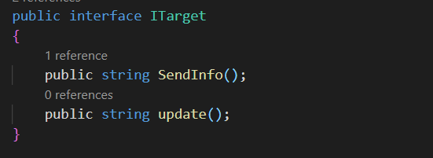
Itarget interface
C# codes

Slide 31
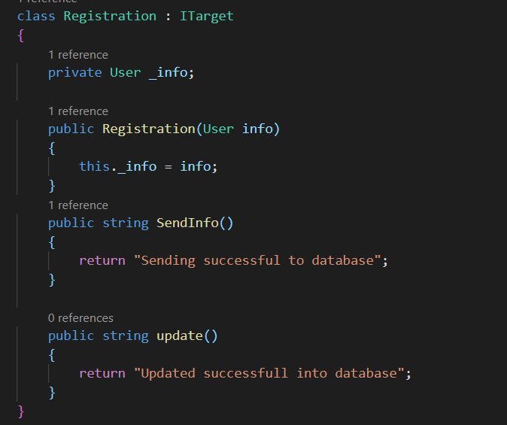
Registration class
C# codes

Slide 32
Bridge

Slide 33
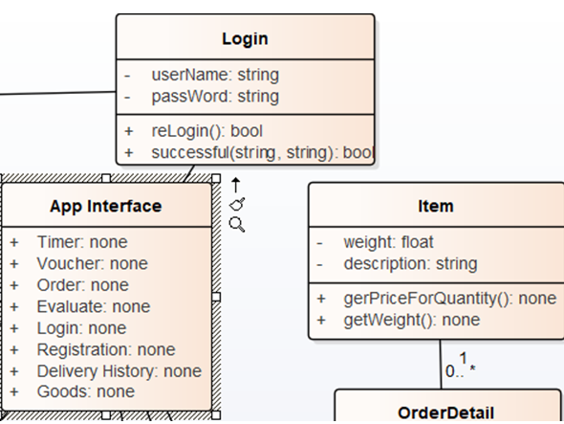
Class Diagram
Reason
After login user and manage will have different screen because they are different position, so bridge in this case is suitable.
Characteristic
Bridge can be recognized by a clear distinction between some controlling entity and several different platforms that it relies on.

Slide 34
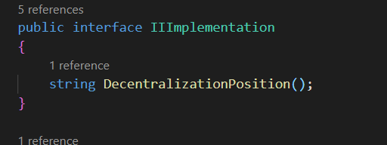
IIImplementation interface
C# codes

Slide 35
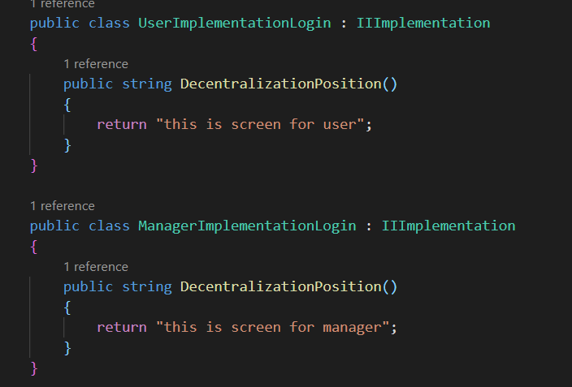
Insert here
C# codes

Slide 36
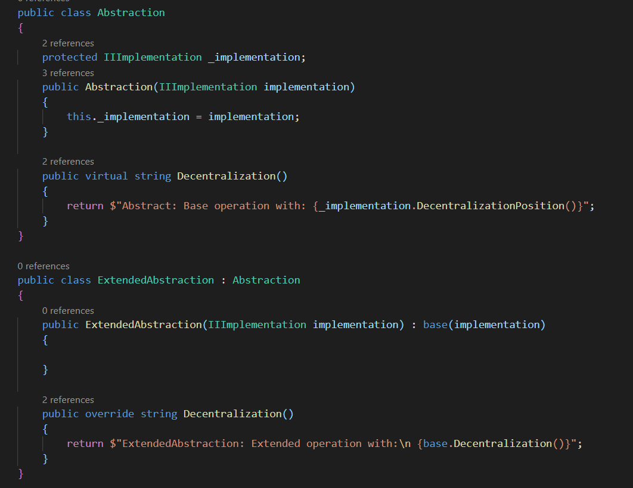
Abstraction class
C# codes

Slide 37
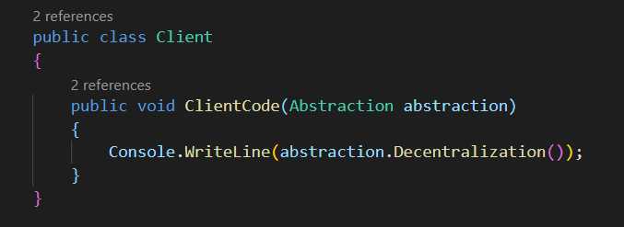
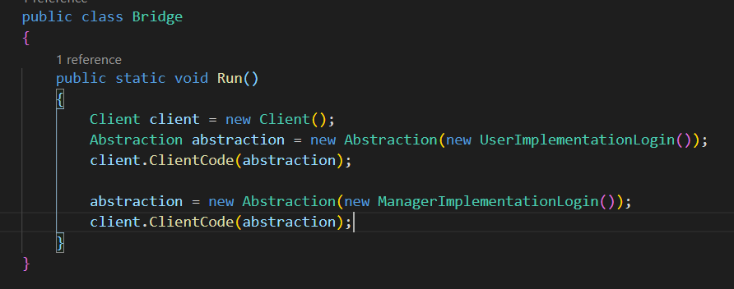
C# codes

Slide 38
Visitor

Slide 39
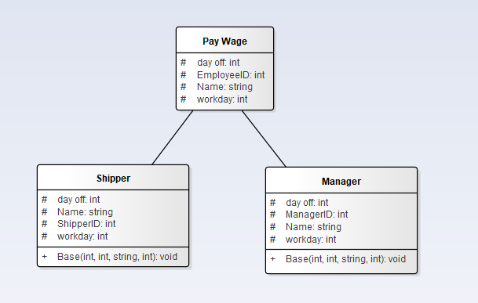
Class Diagram
Reason
With the features of the visitor to help implement the payroll function for employees, we decided to choose the visitor pattern
Characteristic
The visitor pattern or visitor design pattern is a pattern that will separate an algorithm from the object structure on which it operates. It describes a way to add new operations to existing object structures without modifying the structures themselves.
This characteristic makes visitor patterns a way to implement the open/closed principle (OCP).

Slide 40
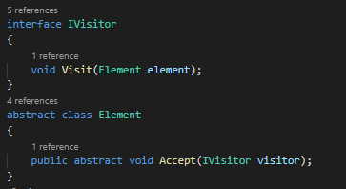
C# codes

Slide 41
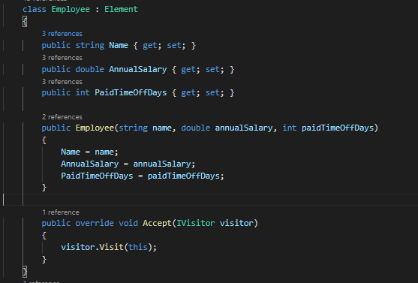
C# codes

Slide 42
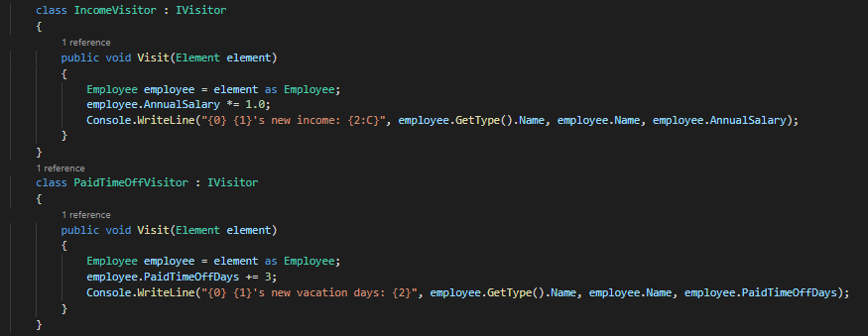
C# codes

Slide 43
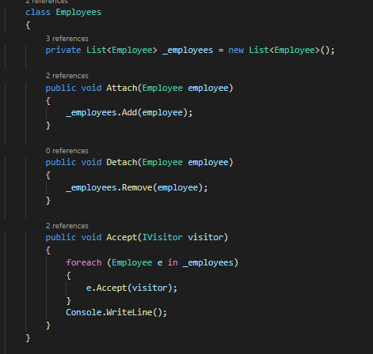
C# codes

Slide 44
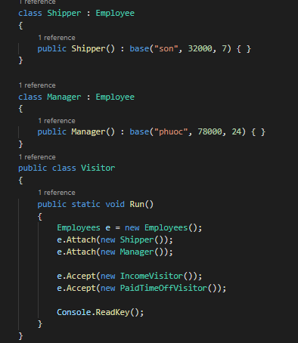
C# codes

Slide 45
Thank you

